Slide 1

Presentation on Wear Measurement
Irwin O. Toppo
Mechanical engineering
Indian Institute of Science, Bangalore, India

Slide 2
Classification of wear
Definition : Wear is progressive damage, involving material loss , occurs on the surface as a result of relative motion between the surfaces.
Type | Typical characteristics and definitions | observed In
Sliding wear (delamintation wear) | Wear due to localized bonding between contacting solid surfaces leading to material transfer between the two surfaces or the loss from either surface. Plastic deformation, crack nucleation and propagation in the surface | Sliders, bearing, gears and camshaft.
Fretting wear | Wear arising as a result of fretting (Small amplitude oscillatory motion, usually tangential, between two solid surfaces in contact). | Press fit parts with a small relative Sliding motion
Abrasive wear | Wear due to hard particles or hard protuberances forced against and moving along a solid surface. | Sliding surfaces ,earth-removing Equipment
Erosive wear (solid particle impingement) | Wear due to mechanical interaction between that surface and a fluid, a multi component fluid, or impinging liquid or solid particles | Turbine, pipes for coal slurries and helicopter blades
Fatigue wear | Wear of a solid surface caused by fracture arising from material fatigue. | Ball bearing, roller bearing glassy solid slider
Cavitation wear | A form of erosion causing material to wear by the action of vapour bubbles in a very turbulent liquid. | Soft Bearing Surfaces

Slide 3
Wear Measurement
Archard wear Equation :
Wα w =wear
w = Normal Load on contact
H= surface hardness of the wearing material
K= wear coefficient (dimensionless)
W= K
= is called Dimensional wear constant
Unit =(volume )/(Load/meter)

Slide 4
Wear Dependence
For Dry/unlubricated surfaces sliding
Normal Load
Relative sliding speed
The initial temperature
Thermal, Mechanical , chemical properties of the material in contact
No simpler Model to explain wear

Slide 5
MECHANISM
IDENTIFICATION OF WEAR
Examination of the wear debris (collected)
large lumps imply- adhesive wear
fine particles- oxidative wear
chip like particles-abrasive wear
flake like particles-delamination wear
Examination of the worn surfaces:
Heavy tearing implies -adhesive wear
Scratches imply -abrasive wear
burnishing indicates –non adhesive wear

Slide 6
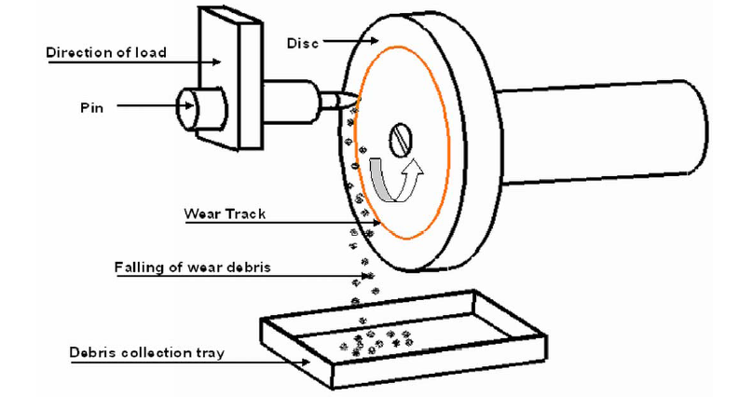
Experimental Set-up
Schematic diagram of loading configuration of Pin-on-Disc.

Slide 7
Methods
pin and disc were fitted.
wear track diameter was measured.
Load applied in the dead cell.
Values of displacement , Time, speed, load and diameter of disk were entered.
Displacement value of every second and coefficient of friction were noted from LVDT.
wear values were calculated from displacement value .

Slide 8
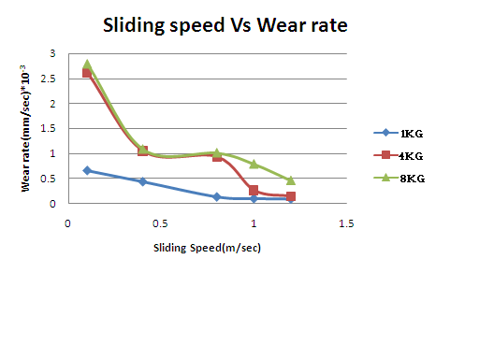
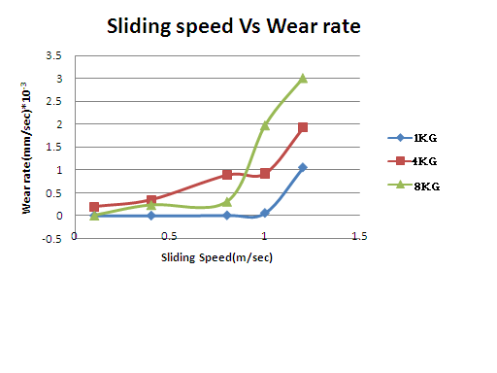
Wear Rate
Wear rate of Ti-6Al-4V under ambient condition at 1kg,4kg and 8kg
Wear rate of Ti-6Al-4V under vacuum condition at 1kg,4kg and 8kg

Slide 9
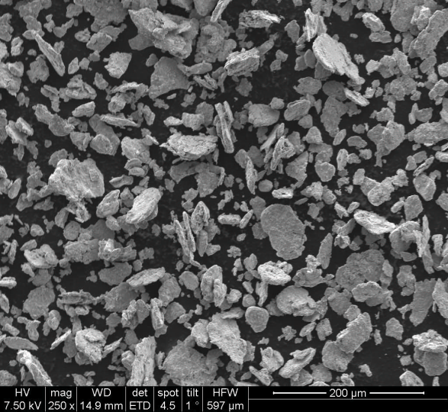
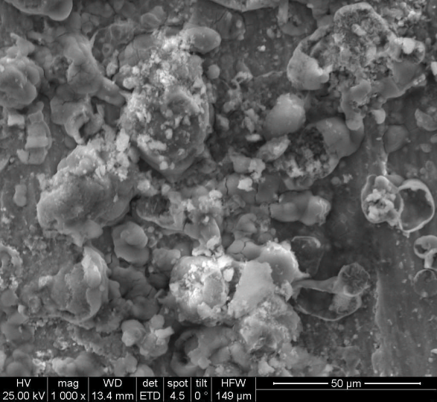
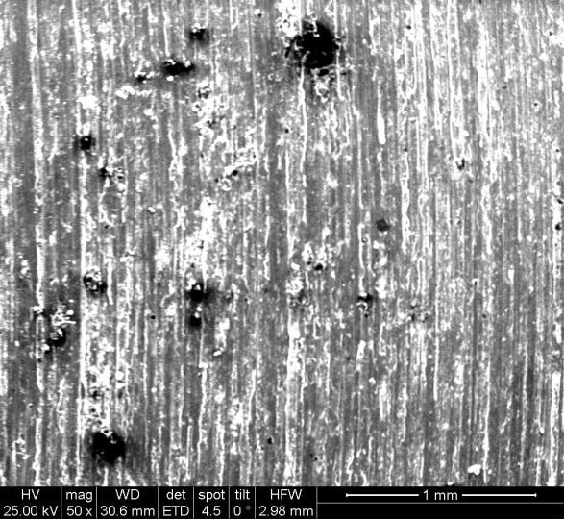
SEM Analysis
Abrasive wear
At Ambient condition
Speed 0.1m/sec at 1kg
Speed 0.8m/sec at 1kg
Source :Materials engg,IISc,Bangalore

Slide 10
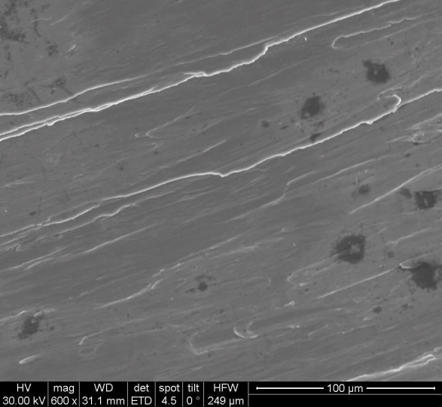
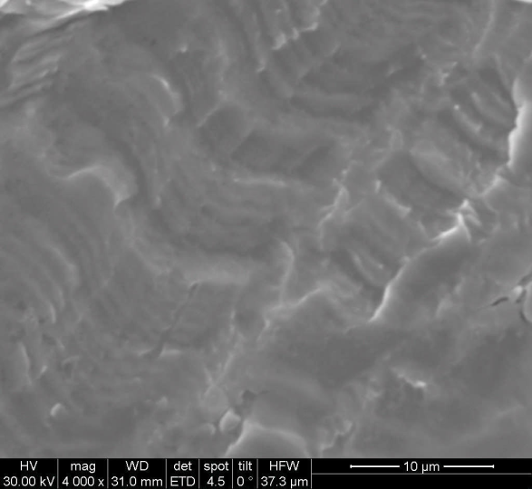
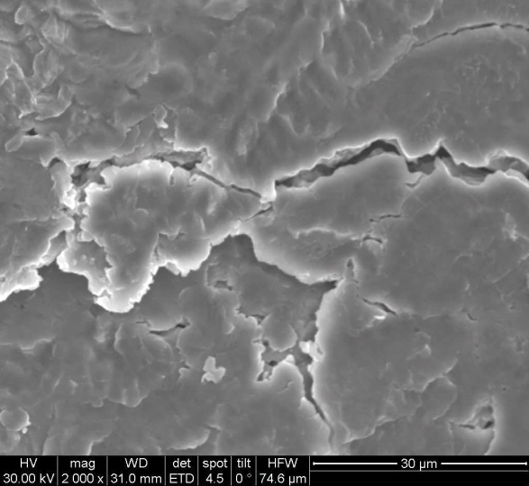
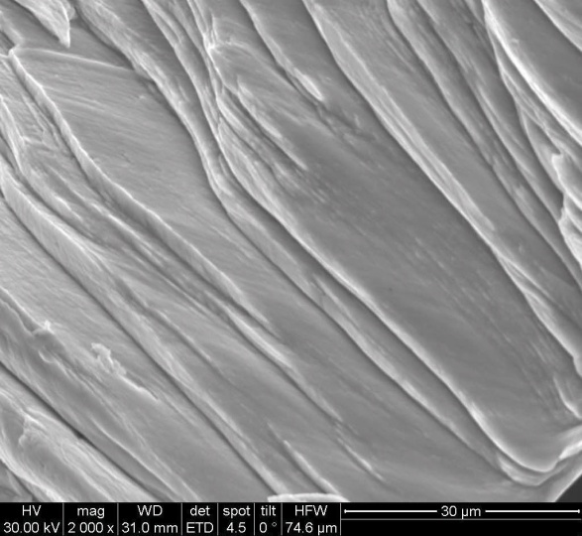
SEM Analysis
At vacuum condition
Speed 0.1m/sec at 1kg
Speed 0.8m/sec at 1kg
Speed 0.4m/sec at 1kg
Speed 0.2m/sec at 1kg
Source :Materials engg,IISc,Bangalore

Slide 11
SAMPLE CALCULATIONS
Wear Rate Calculations
Wear Rate = Slope of the steady state region in the graph
= (Y2 – y1)/(x2 – x1)

Slide 12
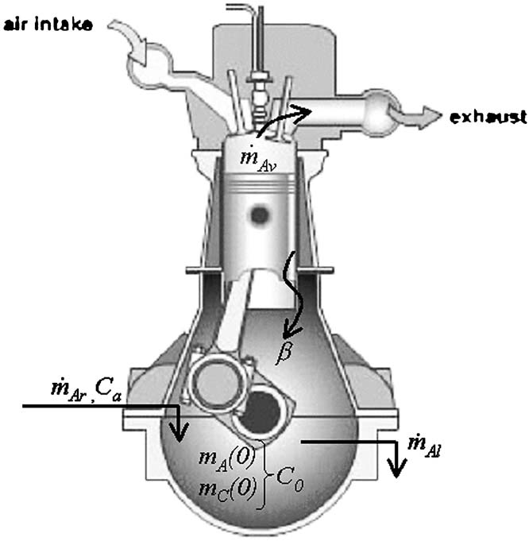
Case study from Tribology international journal
Wear rate determination by oil examination
Helps to avoid secondary damage by identification of wear debris .
Wear debris quantification does not always correlate with the real wear .
Methodology used : spectrometric wear debris measurement data to obtain parameter of wear condition
Reference : Analytic approch to wear tare determinationFor internal combustio engine condition monitering based on oil analysis (Author:V Macian, B Tormos,P.Olmeda, L.Montoro)

Slide 13
Case study from Tribology international journal
The spectrometer purpose is to determine the elemental content of each debris particle .
Inductively Coupled Plasma (ICP) spectrometer is used , typically maximum size of 5 micron can be measured .
Quantative information (concentration) is related to the amount of electromagnetic radiation that is emitted while qualitative information (which element is present is related to the wavelength at which radiation is emitted .

Slide 14
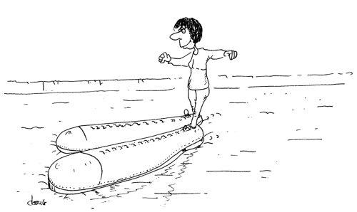
Thank You

